Slide 1


Lithogeochemistry
Random forest applied to XRF data to predict lithology unit
Notes:
My name is Denise Robinson, and today I will present to you a lithogeochemistry project where we examined if XRF data can be used in conjunction with a random forest to predict lithology units.

Slide 2

outline
Background
Objectives and Hypotheses
Dataset
Methods
Findings
Limitations
Deployment
Conclusion
Notes:
We will discuss the project background, the objectives and hypotheses that drove the project, as well as the dataset and methods used. Finally, we will discuss the findings, project limitations, and the best way to deploy such a project in a real setting.

Slide 3

background
Figure 1
Solar Panel and Windmill
World pivoting to sustainable energy
Copper necessary for green technology
Upcoming copper shortage
Mineral exploration necessary to locate new copper reserves
Current copper production insufficient for need (Rapier, 2021)
Notes:
As the world pivots to more sustainable energy, so too must the technologies adapt to a cleaner footprint. Greener technologies must still be manufactured using resources found on earth. Copper, which has both high thermal and conductive properties, is one of the most widely used elements for the development of such tools (Visual Capitalist, 2021). For example, Rapier (2021) reports that each megawatt of energy produced in an offshore windfarm requires 9.6 metric tons of copper, while solar panels need 5 metric tons of copper per MW produced. Not only is copper critical, but the world is currently facing a copper deficit. As such, the discovery and extraction of copper has become a high priority for the renewable energy sector.

Slide 4

background
Figure 2
Wet Lab Chemistry
Core drilling
Lithology logging
Subjective
Lithogeochemistry - process by which lithological units are characterized by their geochemical signatures (Pantazis, 1988)
Traditional labs
Slow
Portable X-Ray Fluorescence (pXRF)
Real-time
Notes:
Core drilling is the process by which intact cylinders of rock are extracted. Once the rock is out of the ground, geologists must perform lithology logging on it. Lithology logging is when geologists assign specific rock units to specific intervals based on the core. Lithology logs are especially important as they can be used spatially to assist in formulating 3D representations of the geology underground. Lithology logging is a critical part of mineral exploration. For a process so critical to the understanding of a project and geologic occurrences, inconsistencies and subjectivism are often displayed in logging between geologists (Gazley et al., 2014). Additionally, it’s often difficult to determine and track such inconsistencies.
Lithogeochemistry is one of the methods deployed to add a level of objectivity to logging. Typically, to obtain the geochemical composition of surface, samples must be split, crushed, and pulverized before being analyzed. The sample preparation process often causes a long lead time between sample collection and actual data acquisition. The use of a portable x-ray fluorescence (pXRF) device provides near real-time chemical compositions by bombarding a substance with x-rays and analyzing the energy and intensity of photos emitted from the substance (Mihut & Ianasi, 2021).

Slide 5
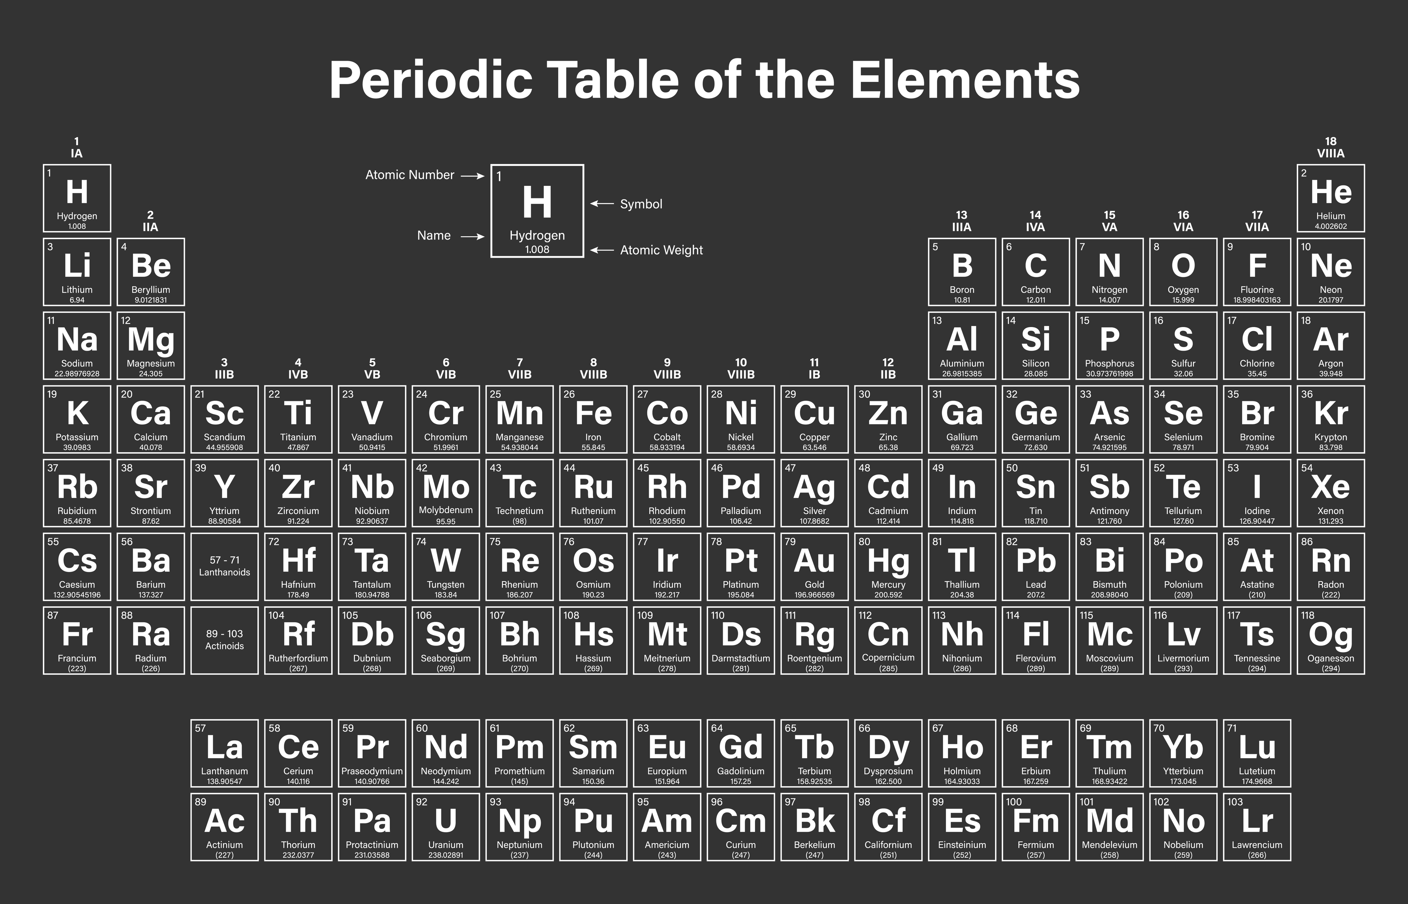
Project aim and hypotheses
Can lithology units be accurately classified using multiple element geochemistry collected using a portable x-ray fluorescence (pXRF) device?
Hypotheses
Ho: All elements (Cu, Rb, Sr, Al, Si, S, K, Ca, Ti, Mn, and Fe) have an impact on the lithology unit.
Ha: All elements (Cu, Rb, Sr, Al, Si, S, K, Ca, Ti, Mn, and Fe) do not have an impact on the lithology unit.
Figure 3
Periodic Table
Notes:
Lithological logging is one of the most important aspects of mineral exploration. Logging of exploration materials such as core or rock chips directly impacts the project. Understanding of the subsurface geology and structures paint the picture of the geologic history responsible for the area. Subsequently, this knowledge can lead geologists to refine exploration targets and gain more understanding of where the minerals in question may exist underground.
That said, there are usually multiple geologists responsible for logging at any given project. For a process so critical to the understanding of a project and geologic occurrences, inconsistencies and subjectivism are often displayed in logging between geologists (Gazley et al., 2014). Additionally, from a data perspective, it’s difficult to determine and track such inconsistencies. It is therefore important to incorporate objective classification methods to the lithology logging, such as utilizing the portable x-ray fluorescence (pXRF) device.
Can a combination of heavy and light elements provided by pXRF readings every ten centimeters be used to accurately categorize the lithology unit of a copper porphyry deposit located in Arizona, United States? The heavy elements for this project consist of copper (Cu), rubidium (Rb), and strontium (Sr). The light elements include aluminum (Al), silicon (Si), sulfur (S), potassium (K), calcium (Ca), titanium (Ti), manganese (Mn), and iron (Fe).
Our null hypothesis states that all elements have an impact on the final model and our alternative states that all elements do not have an impact on the final model. For the purposes of our project, impact will be defined has a feature importance of greater than zero.

Slide 6
Dataset
X-Ray Fluorescence Data Collected every 10 cm
Light elements → 15 kV
Heavy elements → 40 kV
Lithology Data
Logged by experienced geologist
Final dataset created by joining lithology data to XRF data
Removed elements with few numerical returns
Removed rows that did not contain data for all elements
Notes:
The pXRF data was collected and processed by the Center for Advanced Subsurface Earth Resource Models (CASERM), which is a research consortium comprised of the Colorado School of Mines and Virginia Tech (CASERM, 2022a). Separate datasets (heavy and light elements) were provided. These data were delivered separately, as they were scanned using different pXRF device settings. Specifically, the light elements were collected using 15 kV and 24 mA, while the heavy elements were gathered using 40 kV and 8 mA using a silver (Ag) anode x-ray tube in a helium atmosphere (CASERM, 2022b). As part of the transformation process the heavy and light elements were combined into a single data set, the join id was created by concatenating the hole number with the ‘from’ and ‘to’ columns. Only intervals that occurred in both datasets were considered. Further, some of the elements contained a significant number of ND or not detectable values. Again, as part of data transformation, these elements were removed from the data. Of the remaining elements, any samples containing any ND values were also removed. This process was completed to ensure only readily detectable elements would be considered for the predictive model. The final dataset contains the following elements: Al, Si, S, K, Ca, Ti, Mn, Fe, Cu, Rb, and Sr.
The lithology logging was completed on site in Arizona by an experienced geologist. To combine the lithology log with the pXRF data, the interval values (from and to) were used. Only pXRF readings that occurred completely with in a lithology unit interval were included. In other words, if a pXRF value crossed a lithology break, it was excluded from the final data. The final dataset had 3917 entries.

Slide 7
methods
SQL Server
Combine datasets into one
Orange
Data exploration and descriptive statistics
Python
Random Forest
Notes:
SQL Server was used to join the datasets into a single table
To analyze the data two main programs were deployed: Orange, an open source data visualization tool and PyCharm, a python graphical user interface (GUI).Descriptive statistics were calculated for each of the independent variables, in this case, the separate elements using the Orange. This process provided insights into the distributions and possible outliers of each element. For actual data analysis and modeling, Pycharm and python libraries were used. First, the data was partitioned into 70% for training data and 30% into a test set. The model used for this project was a random forest. Random forests are supervised machine learning ensemble classifiers (Provost et al., 2017) (Yiu, 2019).
Random forests are considered ensemble classifiers as they combine many decision trees into a single model, which leads to less overfitting. In this case, our random forest combined the effects of 500 decision trees. Random forests have also been previously proven as successful models to use for lithology classifications based on pXRF data (Trott et al, 2022). To assess the results of the model, the final accuracy percentage and a confusion matrix were used. Finally, to evaluate the null hypothesis, we will determine if all independent variables exist with in the final classification model.

Slide 8
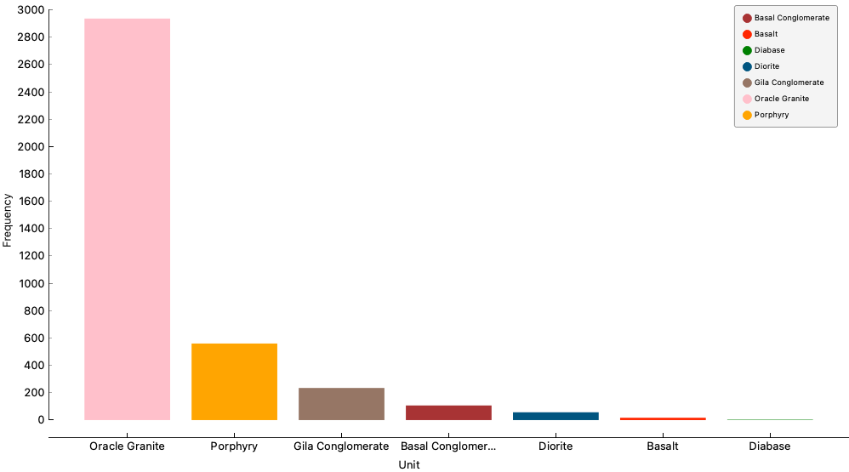
findings
Figure 4
Unit Frequency in Bar Chart
Significantly more instances of oracle granite
Very few instances of diorite, basalt, and diabase
Random forests are acceptable for data with disproportional target variables (Zhang, 2015).
Note. Frequency bar chart of lithology units.
Notes:
This bar chart clearly illustrates the skewness of the data. Oracle Granite comprises the vast majority of the dataset with 75% of the total data set having been logged as Oracle Granite. With some model types, such disproportionality among the target variables could affect the performance of a machine learning model, but random forests are considered appropriate algorithms in this case as they are ensemble models and use numerous individual classification trees (Zhang, 2015).

Slide 9
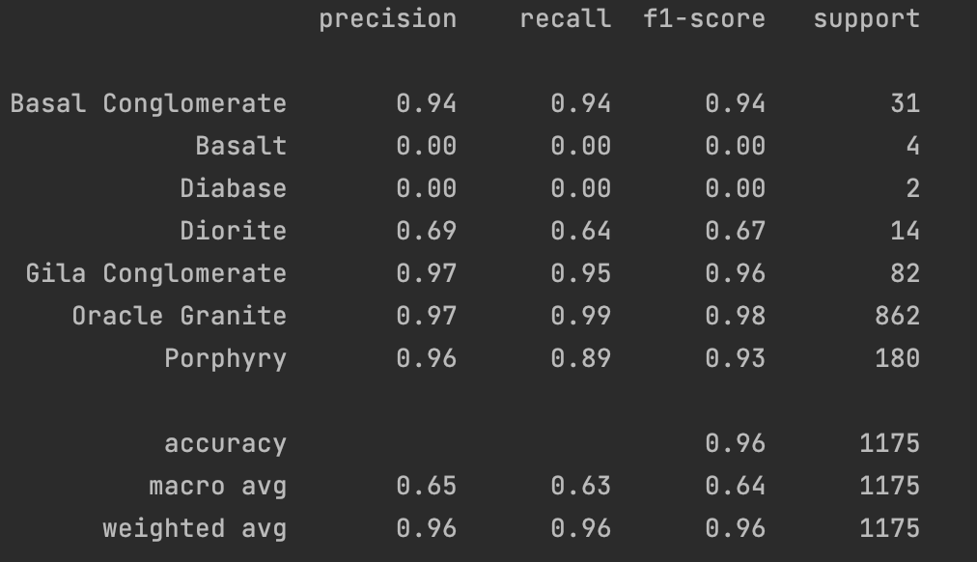

findings
Figure 5
Classification Report
Overall model accuracy of 96%
F1-Score
Deeper dive into model performance
Combination of precision and recall
Successful → Basal conglomerate, gila conglomerate, oracle granite, porphry
Moderately Success → Diorite
Model Failure →Basalt, Diabase
Note. Screen shot of classification report using the Scikit library.
Notes:
Our model had an overall accuracy of 96%. The model performed well with some lithology units and poorly with others. If we view the classification report, we can see that basalt and diabase both had very few instances tested by the random forest with four and two, respectively. This is a direct consequence of our small dataset and highly skewed classification variables. Further, based on the f-1 score, which takes both precision and recall into consideration, the model performed well for the basal conglomerate, gila conglomerate, oracle granite, and porphyry units. It performed moderately at classifying diorite, and it failed to classify basalt or diabase. Basalt and diabase did not have enough test instances to be considered adequately tested.

Slide 10
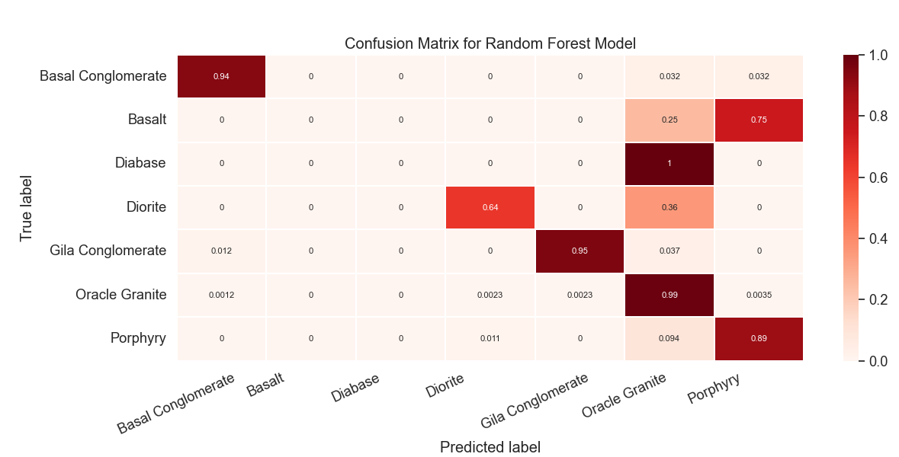
findings
Figure 6
Confusion Matrix
Note. Confusion matrix produced using Scikit Learn and Matplot.
Notes:
This confusion matrix is simply another way to examine how well our model performed. We can clearly see along the diagonal line, which are the cells where the predicted values and true values are the same. For example, if we look at oracle granite, we can see that 99% of the oracle granite was predicted, oracle granite was the correct or true label. The higher numbers in the diagonal, the better our model did at predicting the appropriate lithology label. This corresponds to the precision column on the previous slide.
The confusion matrix also illustrates where basalt, diabase and diorite all had instances where the predicted value was granite. This is possibly a consequence of our extremely disproportionate dataset, where oracle granite comprised of 75% of the entire dataset.

Slide 11
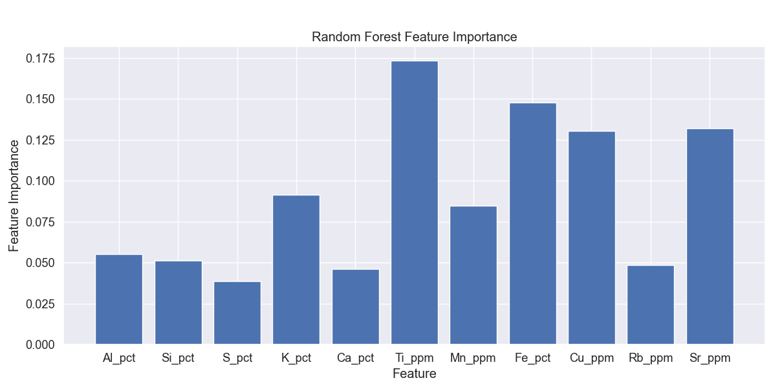
findings
Figure 7
Feature Importance
Feature Importance
Ranks the usefulness of input variables
Which elements were the most useful to the model?
Ti, Fe, Cu, Sr
Note. Bar chart depicted the feature importance for predictor variables in random forest model created with Scikit and Matplot.
Notes:
To test our null hypothesis, which states all predictor variables will have an impact on the final model, we produced this feature importance chart using the Scikit library. The feature importance indicates the relative importance of each variable (Brownlee, 2020). For our purposes, a feature with an importance greater than zero was be considered as part of the final model, thus we fail to reject our null hypothesis.
The four most important elements from our dataset were titanium, iron, copper and strontium. The means that these four elements are the most useful when determining the lithology unit, so the geologists can narrow their focus when using an XRF in the field.

Slide 12
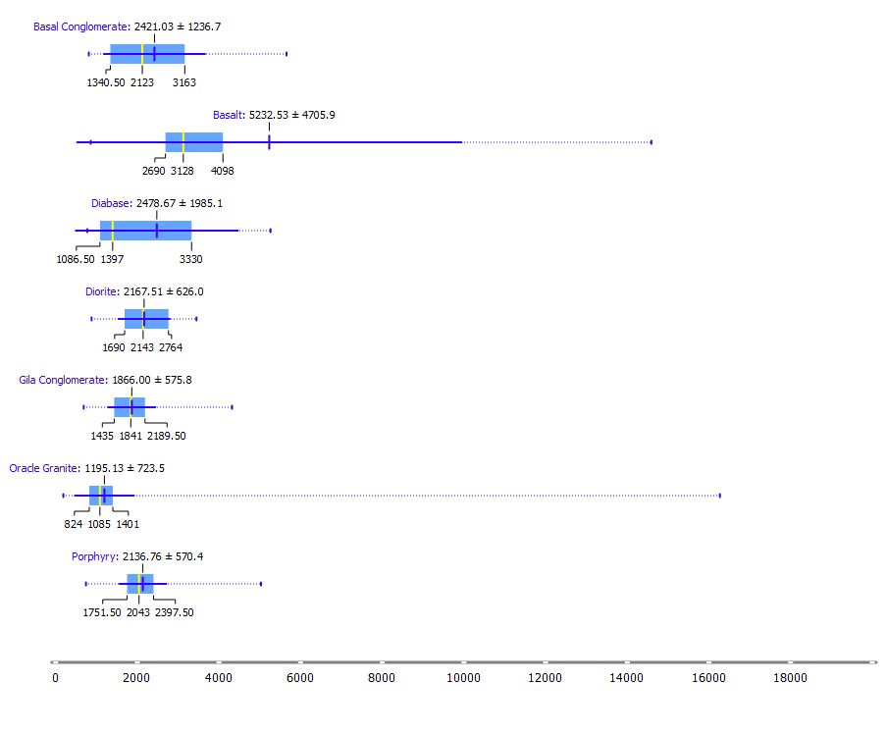
Deployment
Figure 8
Titanium Distribution per Lithology Unit
Regularly re-run forest with more data
Evaluate new model performance
Update distribution plots
Print and Laminate for field use
Note. Distribution of titanium per lithology unit.
Notes:
Arguably, the most important part of a predictive analytics project is deployment. We recommend the random forest be re-run systematically as more XRF and more lithology logging data becomes available. The model will continue to refine as more data is added.
Until such time that the model can be deployed in a field setting, we aim to provide geologists with tools to help them correctly identify lithologies. Since we know titanium is the most important element when classifying the lithologies, we created a distribution plot of titanium grouped by lithology. These plots act as useful visualizations for the loggers to quickly see how the elements plot across different lithologies. These can also act as guides to determine if lithologies were logged incorrectly. For example, Most of the titanium for the oracle granite is clustered in a range of about 1200 ppm plus or minus about 725, yet we can clearly see a rock logged as an oracle granite with extremely high titanium

Slide 13
Limitations
Only one drill hole scanned
Disproportionate data set
Many elements contained few quantitative responses
Removed elements
Removed entries with out complete data
Notes:
Our main limitation was lack of data. At the time of this project, only one drill hole had been scanned for continuous XRF. More drill holes and more instances of lithology logging and XRF data to feed into the random forest would be extremely useful to build a more robust model. Another limitation was the the XRF data itself. Many of the elements contained NDs or no data. Because the detection limits for scan are different, it would have introduced biased and errors into the data if we had simply set the NDs to a specific number, so we ended removing scans that contained NDs.

Slide 14

Conclusion
Figure 9
Trees in Forest
Copper exploration necessary for greener technologies
Lithology logging essential to exploration
Subjective by nature
Add objectivity to logging by incorporating XRF data
Random Forest
Notes:
Lithology logging is essential to mineral exploration, but tends to be subjective by nature. We demonstrated that the use of rapid geochemical results produced using a XRF unit in conjunction with a random forest machine learning algorithm is an effective technique to add objectivity to the lithologic logging of a copper porphyry deposit in Arizona. We discussed the background, objectives, dataset, methods, findings, limitations and deployment options

Slide 15
references
Brownlee, J. (2020, March 29). How to Calculate Feature Importance With Python. Machine Learning Mastery. https://machinelearningmastery.com/calculate-feature-importance-with-python
CASERM. (2022a, August 25). Center for Advanced Subsurface Earth Resource Models. Center for Advanced Subsurface Earth Resource Models. Retrieved September 24, 2022, from https://caserm.mines.edu/
CASERM. (2022b). Calibration Data Generation Laboratory assays graphed against Minalyze results for same intervals. Center for Advanced Subsurface Earth Resource Models. Center for Advanced Subsurface Earth Resource Models.
Gazley, M. F., Tutt, C. M., Fisher, L. A., Latham, A. R., Duclaux, G., Taylor, M. D., & de Beer, S. J. (2014). Objective geological logging using portable XRF geochemical multi-element data at Plutonic Gold Mine, Marymia Inlier, Western Australia. Journal of Geochemical Exploration, 143, 74–83. https://doi.org/10.1016/j.gexplo.2014.03.019
Mihut, N.M., & Ianasi, C. (2021). Overview of x-ray fluorescence spectrometry. Fiability & Durability / Fiabilitate Si Durabilitate, 27(1), 71–74.
Provost, F., Hibert, C., Malet, J.-P. (2017). Automatic classification of endogenous landslide seismicity using the random forest supervised classifier. Geophysical Research Letters, American Geophysical Union. 44 (1), 113-120. https://doi.org/10.1002/2016GL070709.
Rapier, R. (2021, September 17). Will the copper deficit derail the Renewable Revolution? Forbes. Retrieved September 15, 2022, from https://www.forbes.com/sites/rrapier/2021/09/17/will-the-copper-deficit-derail-the-renewable-revolution/?sh=76f80afc775f
Trott, M., Leybourne, M., Hall, L., & Layton-Matthews, D. (2022). Random forest rock type classification with integration of geochemical and photographic data. Applied Computing and Geosciences, 15. https://doi.org/10.1016/j.acags.2022.100090
Visual Capitalist. (2021, May 20). Visualizing the copper intensity of renewable energy. Visual Capitalist. Retrieved September 15, 2022, from https://www.visualcapitalist.com/sp/copper-intensity-of-renewable-energy/
Yiu, T. (2019, June 12). Understanding Random Forest - Towards Data Science. Medium. Retrieved October 1, 2022, from https://towardsdatascience.com/understanding-random-forest-58381e0602d2
Zhang, Q. (2015). Modern Models for Learning Large-Scale Highly Skewed Online Advertising Data. [Master's thesis, University of California, Los Angeles]. https://escholarship.org/content/qt7mc0k1v8/qt7mc0k1v8_noSplash_68fe9a60ebefb849e7eb26b341d072b0.pdf‌

